Slide 1

GLOBAL LEADERSHIP
FOR THE 21ST CENTURY
Schwarzman Scholars brings together young leaders from around the world who have the demonstrated ability, through their leadership on campus or in the workplace, to bridge different perspectives and produce results on issues of importance.

Slide 2

Tsinghua
University
Tsinghua and Schwarzman Scholars
A leading institution, in Beijing, with a 100-year history of building links
between China and the world
45,000 Students • 20 Schools • 55 Research Institutes
China’s Last Two Presidents; A Nobel Laureate

Slide 3
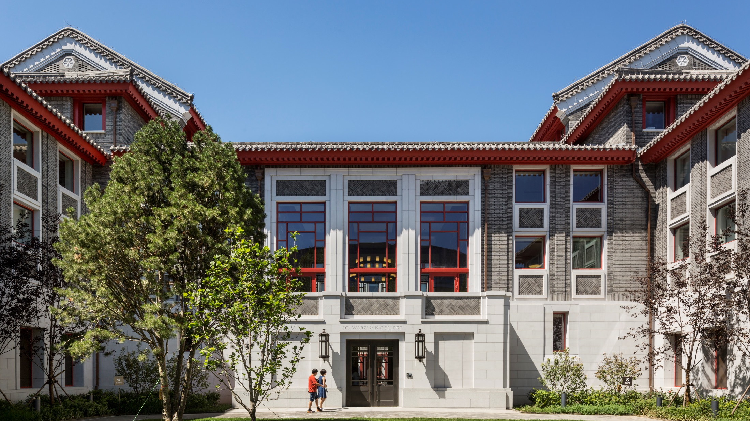
Schwarzman college
Designed to inspire
A world-class facility built to foster cross-
cultural connections and intellectual exchange among students, faculty and visiting leaders.
Schwarzman college

Slide 4

Schwarzman college
Designed to inspire
A world-class facility built to foster cross-
cultural connections and intellectual exchange among students, faculty and visiting leaders.
Schwarzman college

Slide 5

Schwarzman college
Designed to inspire
A world-class facility built to foster cross-
cultural connections and intellectual exchange among students, faculty and visiting leaders.
Schwarzman college

Slide 6
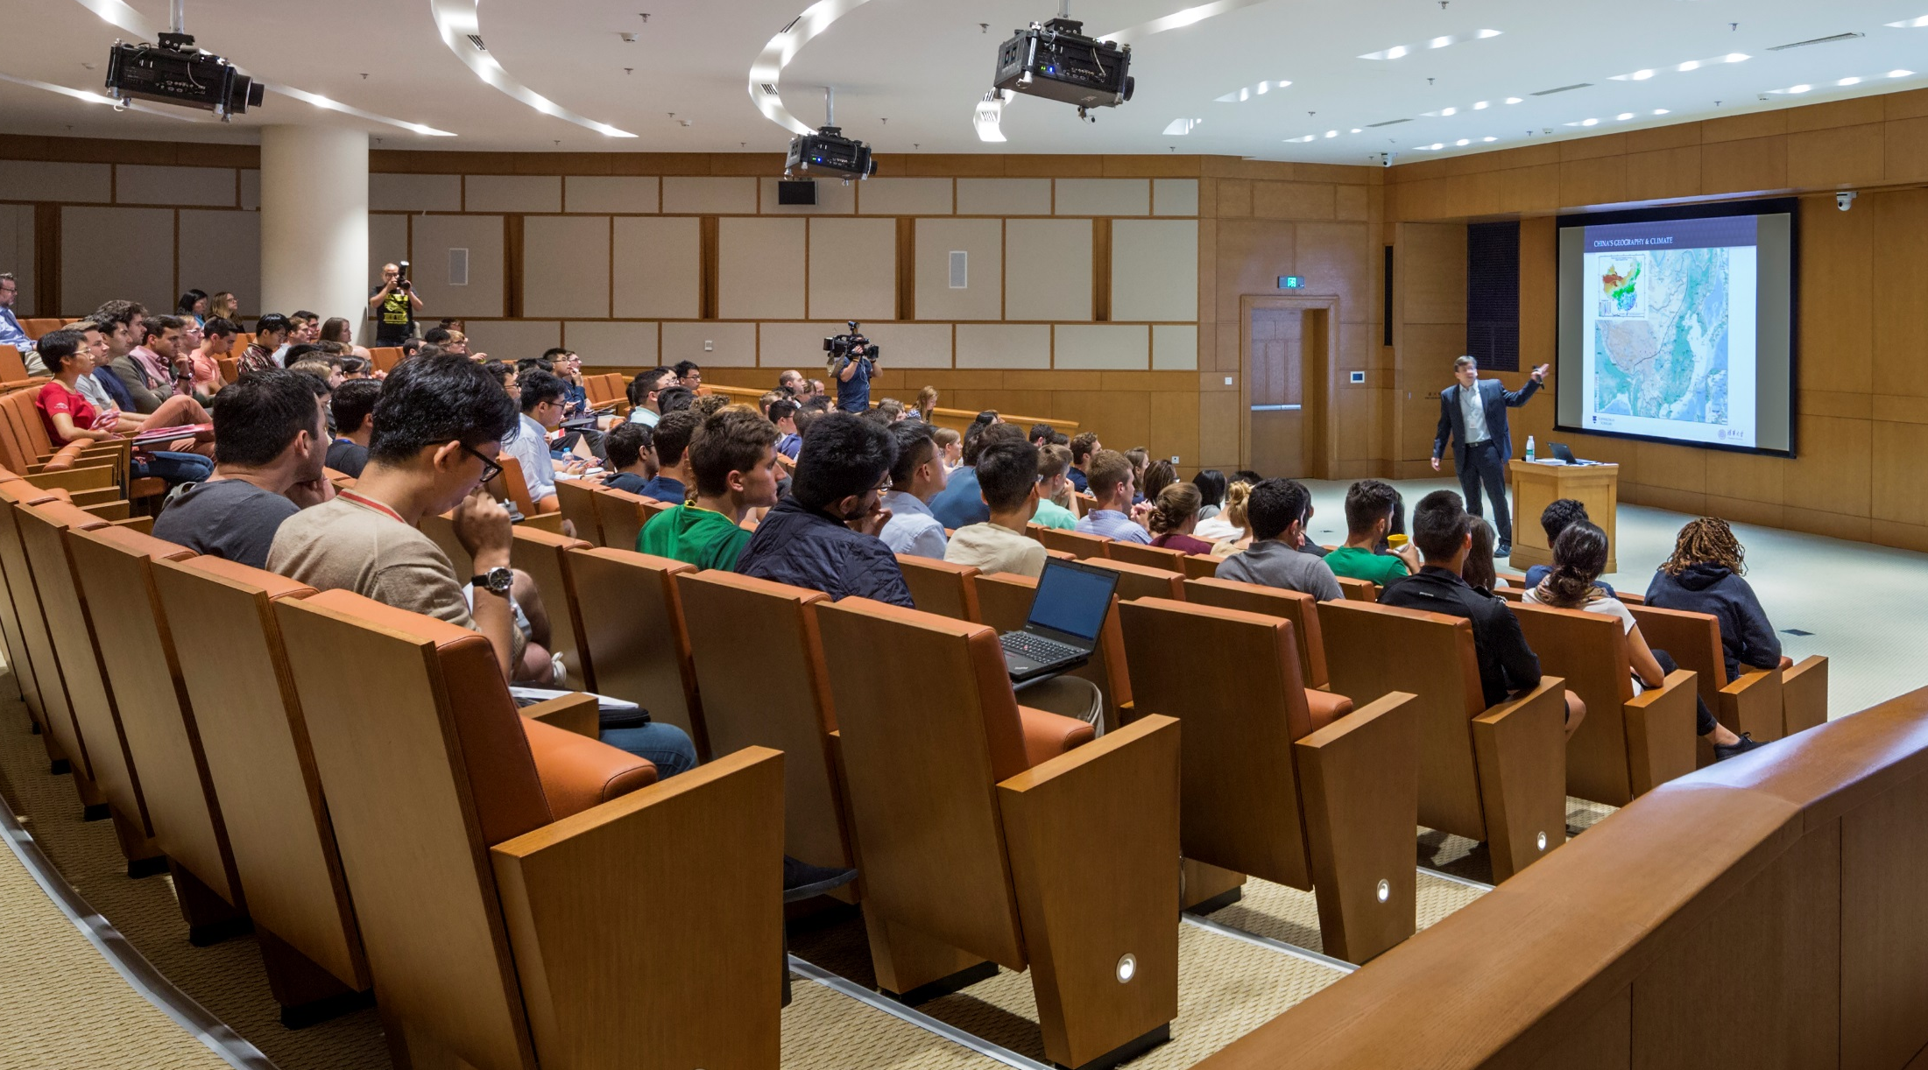
Schwarzman college

Slide 7
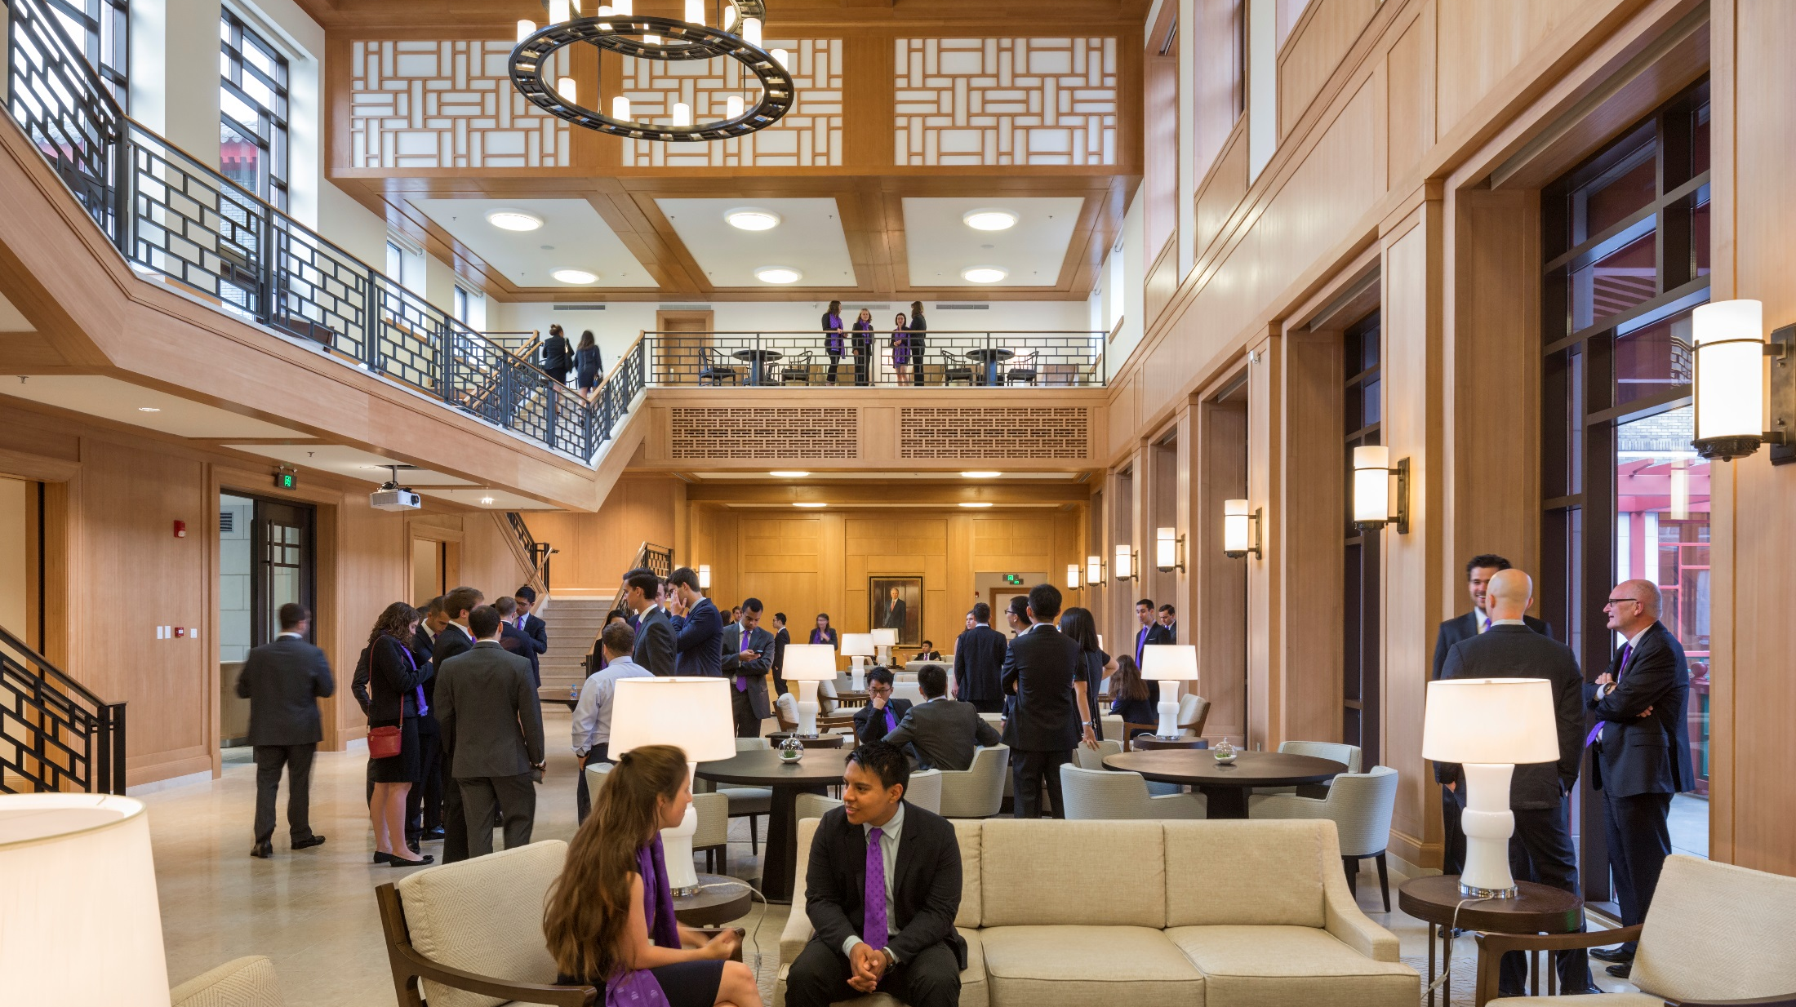
Schwarzman college

Slide 8


academics
Master’s degree in global affairs
Core Curriculum
Three Concentrations:
Public Policy
Economics & Business
International Studies
Mandarin Study
Capstone Project

Slide 9






EXPERIENCE
Real-world Experience in china
Practical Training in the Workplace
Deep Dive Travel Seminars
Mentorships

Slide 10
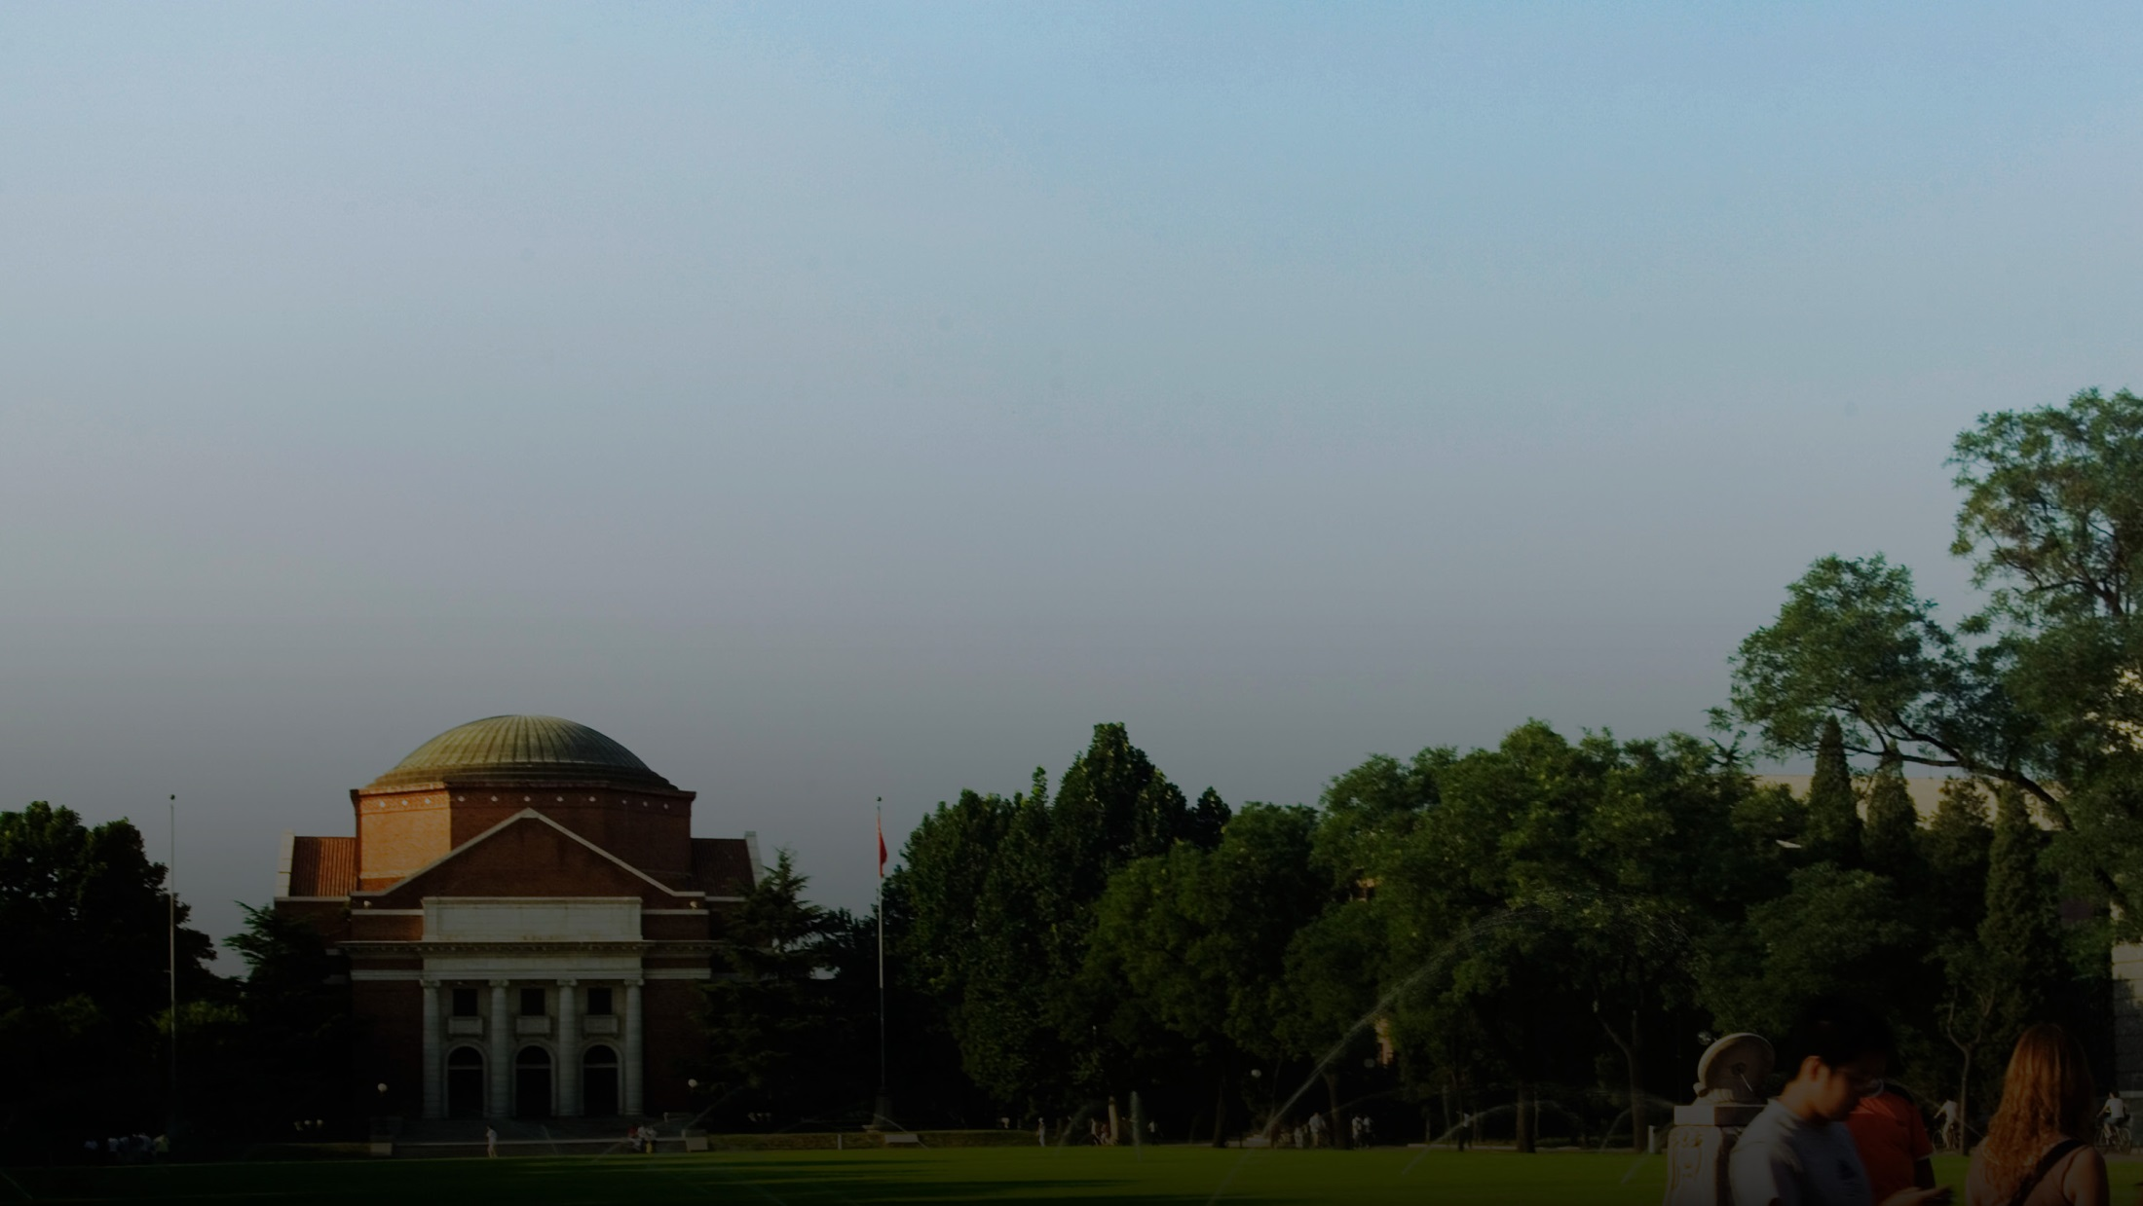
A Comprehensive Scholarship
Tuition and Fees • Room and Board • Program Travel
Books and Supplies • Personal Laptop • Personal Stipend
Health Insurance • Travel to/from Beijing

Slide 11

APPLICATION
Requirements
admissions
18–28 Years of Age
Any Citizenship
No Mandarin Language
Skills Required to Apply
Undergraduate Degree
Undergraduate Transcripts
English Language Test Scores
Essays
Resume/CV
Letters of Recommendation
Video

Slide 12
admissions
What we look for
Leadership
Intellect
Character

Slide 13
Key dates
admissions
April 2018 (January 2018 for China Applicants)
Online application available
September 2018 (May 2018 for China applicants)
Application deadline
October/November 2018 (July 2018 for China Applicants)
Selection period
August 2019
Travel to Beijing to begin pre-semester language
immersion and orientation program

Slide 14


Learn more
WWW.SCHWARZMANSCHOLARS.ORG
Jessica Loh
asia@schwarzmanscholars.org
twitter.com/SchwarzmanOrg
facebook.com/schwarzmanscholars
@schwarzmanscholars
SchwarzmanScholars

