Slide 1

John Monash Scholarships: Investing in Future Leaders of Australia
Ms Alexandra Coelli – Scholarship Coordinator
Mr Steven Ettema – 2018 John Monash Scholar
General Sir John Monash Foundation
Queensland University
May 2018
Notes:
Introduction to myself and Steven

Slide 2

‘The privilege of education carries great responsibilities — it is given not for individual benefit alone, but to befit persons for the higher duties of citizenship and for roles of leadership in all fields to make Australia great’
General Sir John Monash GCMG, KCB, VD, 1920
Notes:
Our Foundation is privileged to use the name of this great Australian and we believe that John Monash Scholars emanate the leadership qualities of John Monash – particularly in the vision to bring about a betterment to Australia through their work and life

Slide 3
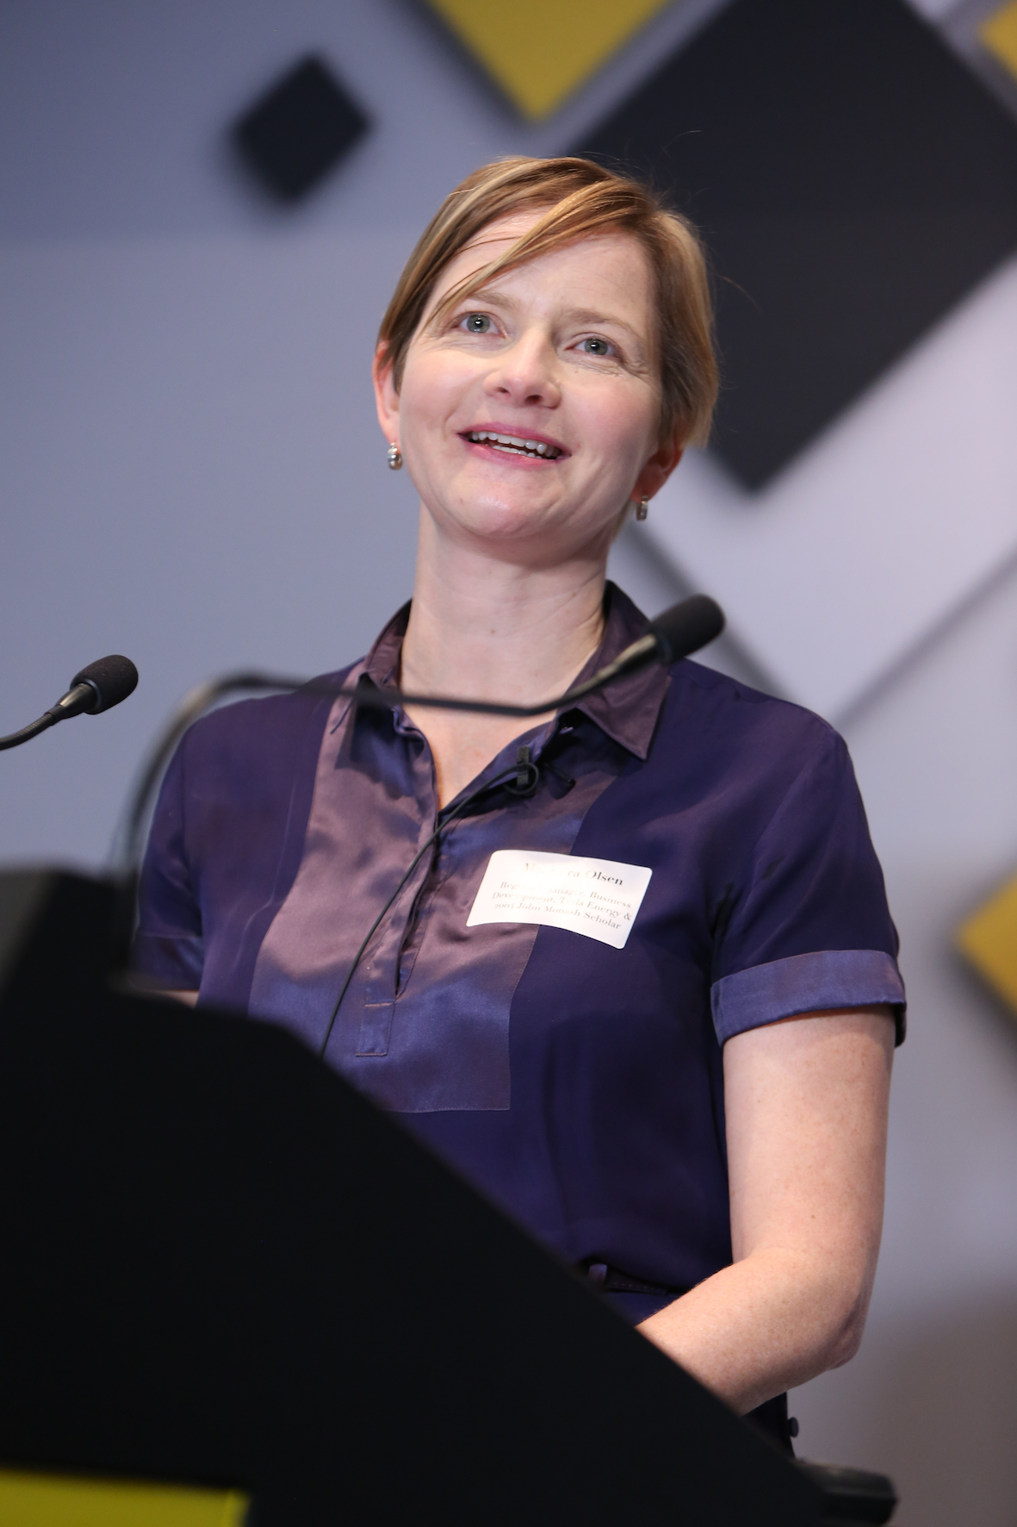
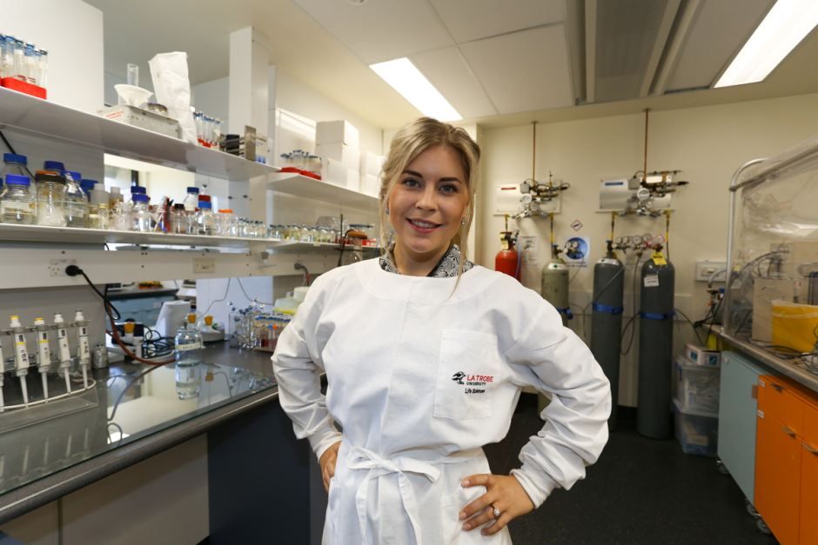
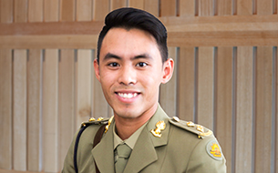
John Monash Scholarships
Uniquely Australian
Offered to outstanding graduates with leadership capabilities, for the benefit of Australia
All Fields of Endeavour
People who are ambitious, broadly curious who will inspire others.
No restrictions by age or geography
Any post-graduate course, at any university in the world. Focus on the best University in your field
Notes:
The Scholarship is uuniquely Australian – to support careers which are of benefit to Australia ​and the world
No age limit, can pursue studies in any field at any university in the world ​- as long as you can explain why it is the best place for you to be
In 2019 we will give between 15-20 Scholarships – we encourage applicants who are looking beyond our traditional destinations of Oxford, Harvard, Columbia and Cambridge (an unusual pitch will pique our interest) . Note: We have an affiliation with Kings College London, a world class University, but not generally considered by Australians. They are offering an additional GBP5,000 to a John Monash Scholar who attends Kings. ​Also IE in Madrid, special scholarship – full fee waiver for a female Scholar and Cranfield – full fee waiver (with some restrictions, please feel free to have a chat with me about this if any of these institutions are ones you potentially have your eye on)
Will join an alumni group of dynamic, curious, high-achieving Australians​
JM Alumni Community a very special group to belong to
​

Slide 4
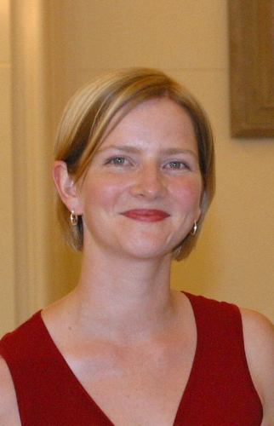
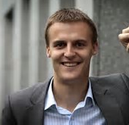
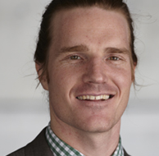
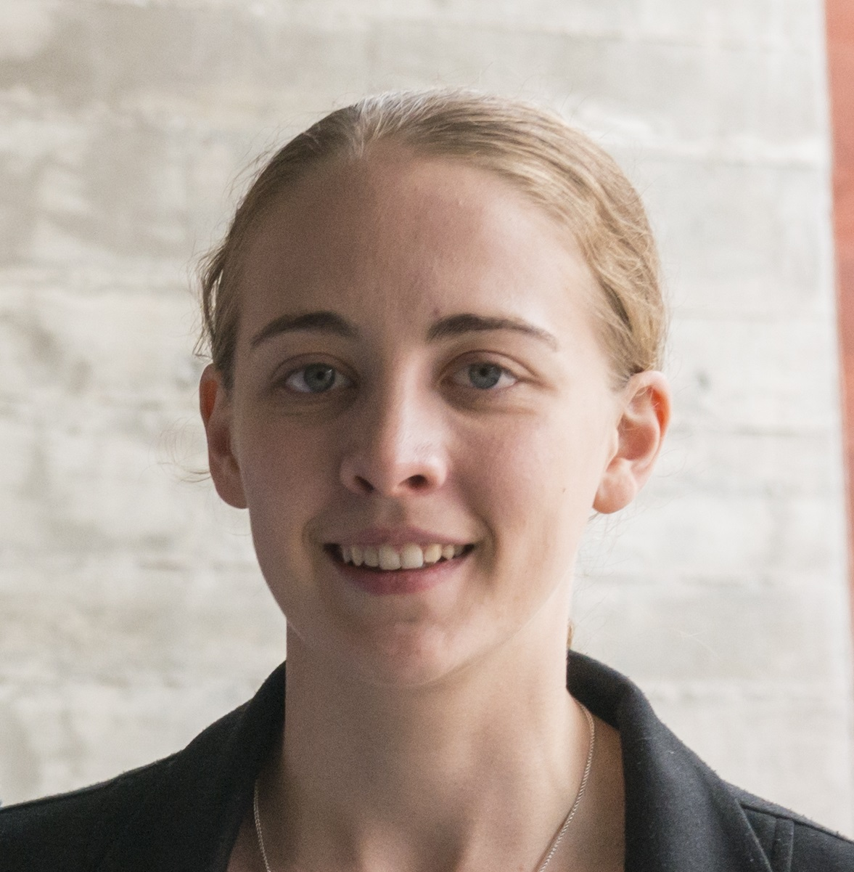
Lara Olsen (2004 John Monash Scholar)
Telsa Motors, Melbourne
“This enabled me to play a leadership role in the establishment of one of Europe’s most exciting energy efficiency companies”
Hugh Evans (2006 John Monash Scholar)
CEO Global Citizen, New York
“I have had the opportunity to be exposed to some of the best minds in the field of global economics”
Dr Sam Brophy-Williams (2012 JM Scholar)
Paediatrician, Darwin Hospital and MSF
“It has made me a part of a remarkable global network of inspiring, intelligent, motivated young Australians”
Claire Daniel (2015 JM Scholar)
Consultant, SGS Economics and Planning
“It gave me the knowledge and skills I need to harness technology to help create better planning outcomes for Australian Cities”
Notes:
What has this Scholarship meant to some of our John Monash Alumni? Draw out a few of these quotes

Slide 5
The Scholarship
$70,000 per year for up to 3 years.
Money is not tied to tuition fees.
The Scholarship does not prohibit
other sources of income, including other awards.

Slide 6
The Foundation looks for
Excellence in your field
Proven academic capability
Demonstrated leadership ability
A vision which will be of benefit to
Australia

Slide 7
Eligibility
Be an Australian citizen
Have completed, or be about to complete, a degree from an Australian university with outstanding results
Plan to start a post-graduate degree
at an overseas institution in 2019

Slide 8
The Application Process
Based on data from the previous selection round
300
Applications submitted
approximately
each year
100
State
interviews
40
National Interviews
18
JM Scholars
Dates for this round: also available on our website
Written applications:
Open May 1st
close August 1st
State Panels:
August 30th – September 26th
National Panel:
October
15th, 16th, 18th & 19th
  Scholars Announced:
  December 2018

Slide 9
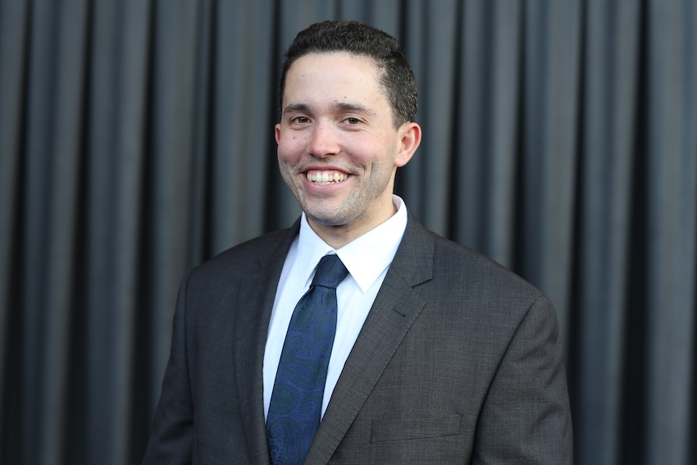
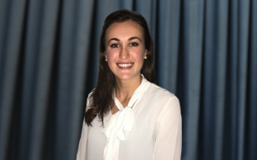
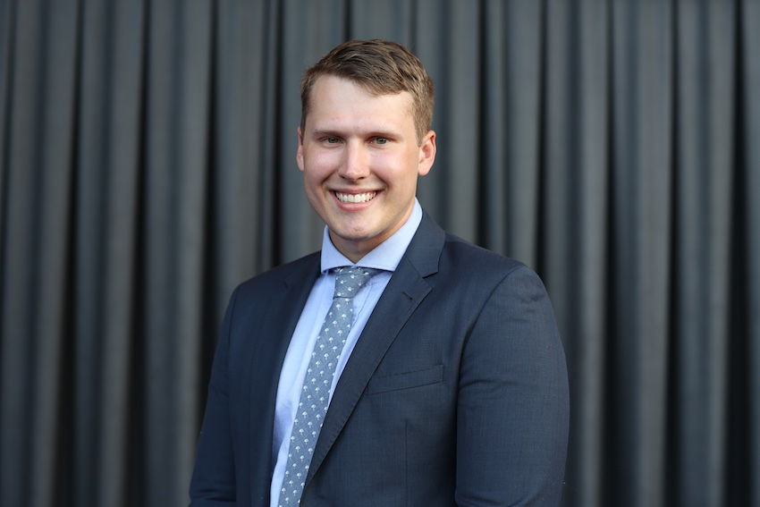
15 John Monash Scholars with degrees from The University of Queensland
Jordan English
Bachelor of Civil Laws, Oxford
Heather Muir PhD in Scientific Computing, Cambridge
Steven Ettema DPhil in Engineering Science, Oxford
Notes:
There have been a total of 15 John Monash Scholars that have had a degree from Queensland University.
In 2018, there were three successful Scholars that had degrees from this University: Heather Muir – an impressive advocate for women in STEM and computer Scientist
Jordan English – An associate to Justice Edelman of the High Court of Australia with a keen interest in anti-bribery and anti-corruption laws who plans on undertaking his LLM at Oxford this year
Steven Ettema – a numerical modeler and coastal engineer who will undertake a Dphil in engineering Science at Oxford this year.

Slide 10
Get in Touch
For more information about the Foundation, the John Monash Scholars and applying for scholarships, please visit: www.johnmonash.com
Contact us:
E: info@johnmonash.com T: 03 9620 2428
GeneralSirJohnMonashFoundationMelbourne
johnmonashfoundation
@MonashScholars
general-sir-john-monash-foundation
To receive our newsletter, email: info@johnmonash.com
Notes:
Wrap up – invite people to come and talk to us afterwards and then hand over to Steven to talk about his application experience

